Slide 1
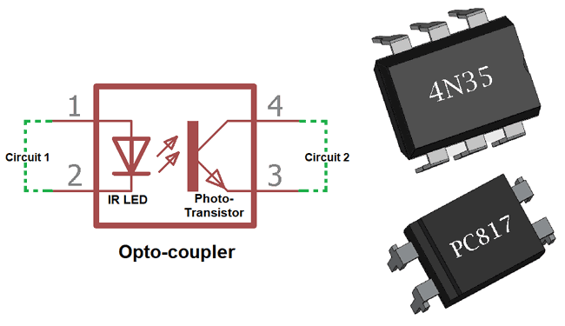
Optocoupler Circuit Design & Detailed Analysis

Slide 2
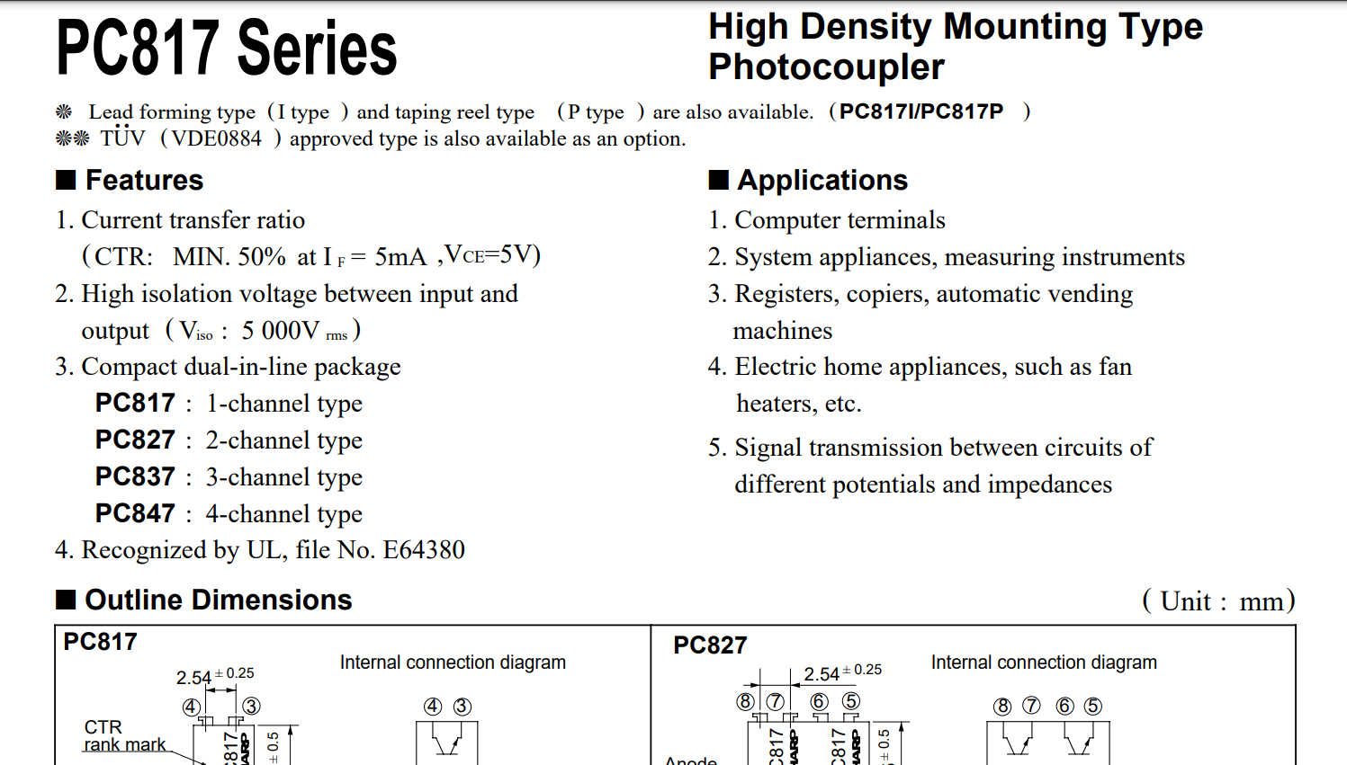
DATASHEET TIPS
Reading the Current Transfer Ratio (CTR) in a datasheet is essential as it defines the ratio of collector current to forward current in an optocoupler. Understanding CTR is crucial for designing and optimizing the performance of the circuit, ensuring effective signal transmission and overall functionality.
The Current Transfer Ratio (CTR) is used for optocouplers to quantify the efficiency of signal transfer from the input (transmitter side) to the output (receiver side). It provides a measure of how much output current can be expected for a given input current. This parameter is critical for designing and predicting the performance of optocoupler circuits, helping engineers ensure reliable and accurate signal isolation between different sections of a system, especially in scenarios where electrical isolation is necessary for safety or functional reasons.

Slide 3
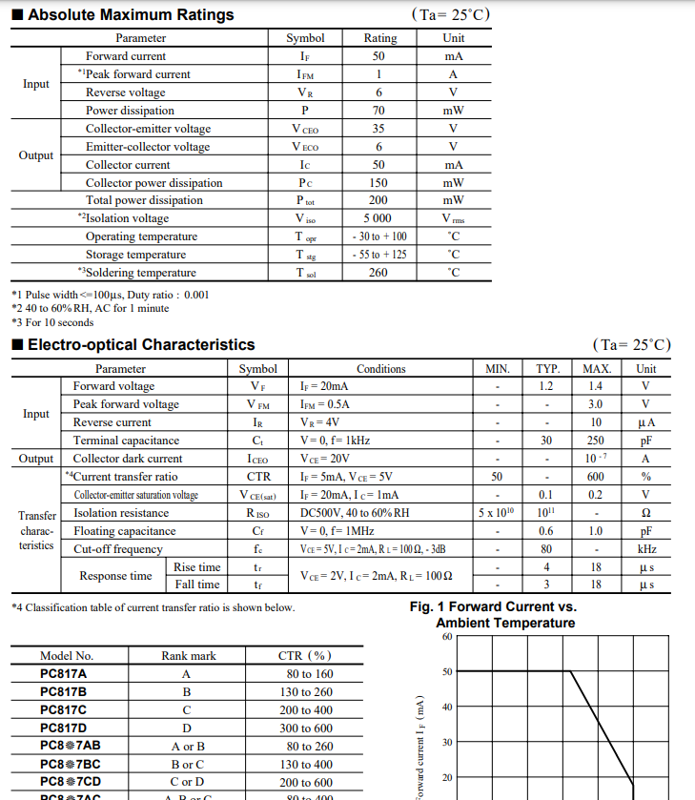
DATASHEET TIPS
Absolute Maximum Ratings (AMR):
Absolute Maximum Ratings refer to the maximum values of voltage, current, power, or other operating conditions beyond which the device may be damaged or its reliability significantly compromised. These ratings are specified by the manufacturer and are crucial for ensuring the proper functioning and longevity of electronic components.
Characteristics of Absolute Maximum Ratings:
Damage Limit:
AMR defines the limits beyond which the device can be permanently damaged. Operating within these specified limits is essential to prevent harm to the component.
Long-Term Reliability:
Exceeding absolute maximum ratings, even for short durations, may impact the long-term reliability of the device. It is crucial to stay within these limits for sustained performance.

Slide 4
DATASHEET TIPS
Environmental Factors:
AMR takes into account external factors such as temperature, humidity, and pressure, ensuring that the device remains within specified tolerances even under varying environmental conditions.
Testing Standards:
Manufacturers determine AMR through rigorous testing under various conditions. Users must adhere to these ratings to guarantee the device's performance and longevity.
Safety Considerations:
AMR often includes safety margins to account for uncertainties and unforeseen conditions, ensuring the device's safety even in non-ideal scenarios.

Slide 5
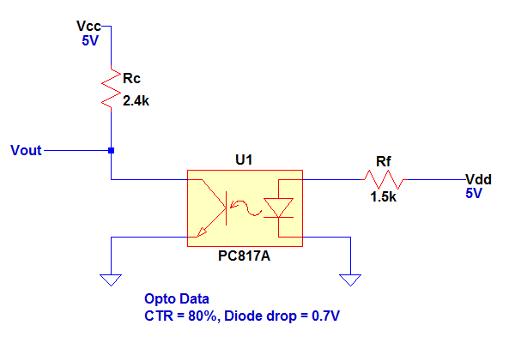
OPTOCOUPLER CIRCUIT DESIGN
Optocoupler circuit design is comparable to designing a BJT circuit, making it more accessible than perceived. Understanding the CTR, or current transfer ratio, is crucial for this design, similar to comprehending the beta or current gain in a BJT circuit. The CTR is defined as the ratio of collector current to forward current, expressed as a percentage:
CTR = ( Ic / If ) x 100%
Here, collector current represents the flow to the collector of the transistor side, while forward current denotes the current flowing to the diode side of the optocoupler.

Slide 6
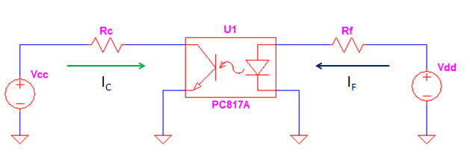
OPTOCOUPLER CIRCUIT DESIGN
Basically the diode side is linked to the transistor side by the device current transfer ratio. Apart from this information, Optocoupler circuit design is just like designing ordinary circuit wherein you are using KVL, KCL, ohms law and so on.

Slide 7
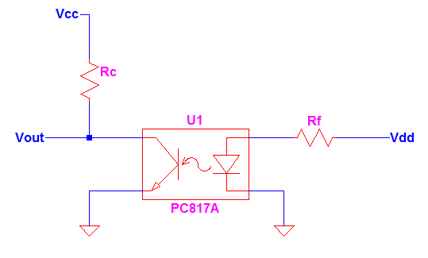
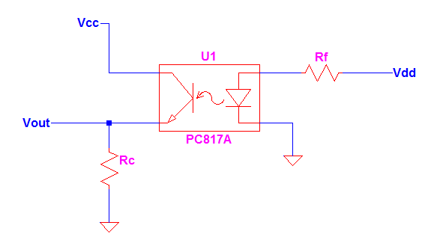
OPTOCOUPLER CIRCUIT DESIGN STEPS
1. Select a Circuit Structure
Simplify your circuit to minimize both cost and failure rates. A reduced parts count not only lowers expenses but also enhances circuit reliability. If your goal is solely to transmit a signal from the primary side controller to the secondary controller, opt for the simplicity outlined below.
The first circuit is normally an inverting one if you are going to saturate the transistor. However if you bias the circuit to operate in the linear region, you can get a voltage higher than zero at Vout node. The second circuit is a non-inverting configuration which is comparable to a common collector configuration of a BJT. But BJT common collector is more complicated than this circuit with the presence of the base current.

Slide 8
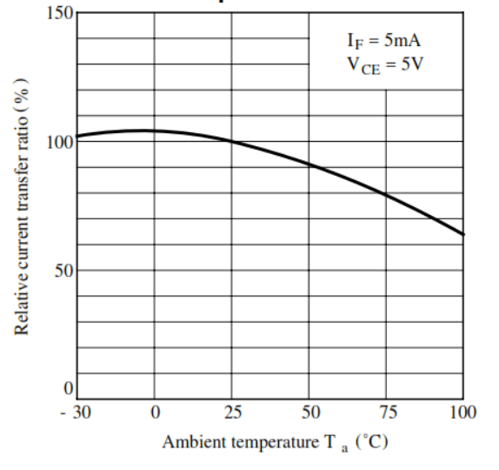
OPTOCOUPLER CIRCUIT DESIGN STEPS
2. Select an Optocoupler Part
The next step in Optocoupler circuit design is to select an optocoupler part. In doing so, you must consider your application. If your application is a switch, you must select a device with a higher minimum CTR. If your application is linear, you can consider using the one with a tight CTR range. A tight CTR will correspond to a smaller variation.
If the design is to be exposed in high surrounding temperatures, you better select an optocoupler with a CTR that will not much affected with the ambient temperature. Optocoupler CTR will decrease with increasing temperatures. For example in below graph, the relative CTR will decrease much at 100’C ambient temperature.

Slide 9
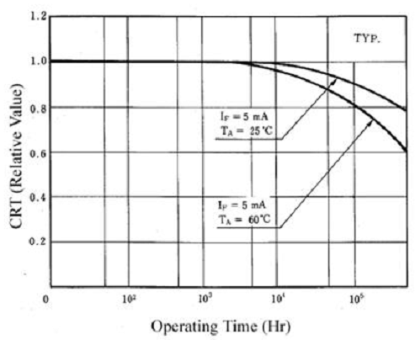
OPTOCOUPLER CIRCUIT DESIGN STEPS
For long term product operation, you better consider also the life expectancy curve. As you see in the graph below, CTR will decrease as the device got aged.

Slide 10
OPTOCOUPLER CIRCUIT DESIGN STEPS
3. Set Circuit Operation
This time you have to set the operating point of the circuit. To make this more informative, we are going to refer to the circuit below.
Define Output Level
The above circuit is can be configured to operate at linear or saturation regions. At saturation the Vout node is zero ideally while above zero but lower than Vcc in linear. When there is no bias in the diode side the level of Vout is simply the same to Vcc. So if you design the circuit as a switch, you must ideally assume a zero VCE or Vout when the Optocoupler is conducting. If the application is linear, you must define a particular level in the Vout node to be used in the design.

Slide 11
OPTOCOUPLER CIRCUIT DESIGN STEPS
Define Rf Value
You can freely choose this value. However, in some applications you need to be careful. Most of the times, Vdd is derived from a digital circuit or device such as MCU or DSP. If so, set the value of Rf in such a way the current rating of the digital circuit or device is not exceeded. For MCU and DSP the sink and source currents are usually ranging from 4mA to 9mA (some other may reach higher than 9mA, you can always check in the datasheet). Supposing the current rating is only 4mA maximum, set actual forward current to at most 80% of it. So Rf would be
If = ( Vdd – Vf ) / Rf
Rf > ( Vdd – Vf ) / ( 80% x Irating )
(Vf is the forward voltage of the optocoupler)

Slide 12
OPTOCOUPLER CIRCUIT DESIGN STEPS
Determine Rc
After defining Rf and the forward current, you can determine the value of Rc.
For Saturation Setting
( Ic / If ) < CTRdevice
Ic = ( Vcc – VCEsat ) / Rc
Rc > [ ( Vcc – VCEsat ) / ( CTRdevice x IF ) ]
For Linear Setting
( Ic / If ) = CTRdevice
Ic = ( Vcc – VCE ) / Rc
Rc = [ ( Vcc – VCE ) / ( CTRdevice x If ) ]

Slide 13
OPTOCOUPLER CIRCUIT DESIGN STEPS
Design Example
Applying the Optocoupler circuit design steps above will make the discussion more informative. Now, let us provide values for the circuit below. The output should provide logic low and logic high level. A logic low level is any voltage below 0.8V while a logic high level is equal to Vcc. The supply Vcc is 5V provided by an MCU with a source and sink current capability of 4mA. The optocoupler CTR is 80% and the diode drop is 0.7V. Consider Vcc of 5V.
Select Rf Value
Rf = [ ( Vdd – Vf ) / ( 80% x Irating ) ]
Rf > [ ( 5V – 0.7V ) / ( 80% x 4mA ) ] = 1.34 kohm
We can set Rf to 1.5k standard value.

Slide 14
OPTOCOUPLER CIRCUIT DESIGN STEPS
Solve for If
If = [ ( 5V – 0.7V ) / 1.5 kohm ] = 2.87 mA
Determine Rc
Rc > [ ( Vcc – VCEsat ) / ( CTR x If ) ] = [ ( 5V – 0V ) / ( 80% x 2.87mA ) ] = 2.18 kohm
We assume VCEsat equals zero for worst case.

Slide 15
OPTOCOUPLER CIRCUIT DESIGN STEPS
Now the final circuit with values is

Slide 16
OPTOCOUPLER CIRCUIT DESIGN STEPS
Design Check
We will verify if the forward current If is not exceeding the maximum source and sink current of the MCU.
If = [ ( 5V – 0.7V ) / 1.5 kohm ] = 2.87 mA
The computed current forward current is safe.

Slide 17
OPTOCOUPLER CIRCUIT DESIGN STEPS
Check if the Optocoupler Can Output a Low Signal
To attain a low signal, the transistor side must saturate. To know if the transistor can really saturate we use below relation.
( Ic / If ) < CTRdevice
Compute of the collector current during saturation
Ic = 5V / 2.4 kohm = 2.08 mA
Ic / If = 2.08 mA / 2.87 mA = 72.47 %
The device CTR is 80%, so the transistor can saturate. In order to ensure a hard saturation, you can add more margins to the collector resistor; say by adding 50% to the computed value.
How about a high logic, will the circuit deliver? The logic high is not a problem because once Vdd is remove the transistor will cutoff, Vout node will see Vcc level

Slide 18
OPTOCOUPLER CIRCUIT DESIGN STEPS
Select Rf Value
Rf > [ ( Vdd – Vf ) / ( 80% x Irating ) ] = [ ( 5V – 0.7 ) / ( 80% x 4 mA ) ] = 1.34 kohm
We can set Rf to 1.5k standard value.
Solve for If
If = [ ( 5V – 0.7V ) / 1.5 kohm ] = 2.87 mA
Determine Rc
Rc = [ ( Vcc – VCE ) / ( CRT x If ) ]
The specified level of Vout is 3V which makes the VCE equal to 2V, so
Rc = [ ( 5V – 2V ) / ( 80% x 2.87 mA) ] = 1.31 kohm
Use a standard value very close to the computed value. In this case we will use 1.3kohms.

Slide 19
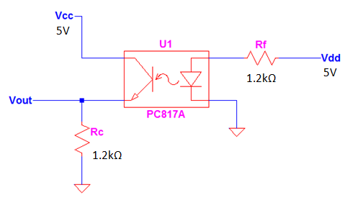
OPTOCOUPLER CIRCUIT DESIGN STEPS
Checking
If = [ ( 5V – 0.7V ) / 1.5 kohm ] = 2.87 mA
Ic = CTR x If = 80% x 2.87 mA = 2.296 mA
Vout = Ic x Rc = 2.296 mA x 1.3 kohm = 2.984 V
The resulting Vout is not exactly equal to 3V because we are using 1.3k for the value of Rc instead of the computed 1.31k.
You can repeat the steps above in any Optocoupler circuit design. Once you use the techniques often, the task will become very easy. Another thing that makes it easier is that there is no base current as with BJT.

Slide 20
ESP32 & OPTOCOUPLER
To calculate the resistor values for the optocoupler circuit using an ESP32 with an input voltage of 3.3V and a drive current of 40mA, we need to consider the PC817 optocoupler's specifications. The information provided includes the forward voltage (VF) and the forward current (IF) at which the optocoupler operates.
From the datasheet, let's assume:
Forward voltage (VF) of the optocoupler is approximately 1.2V (use the typical value).
Forward current (IF) required for proper operation is 5mA.
Now, let's calculate the resistor value (Rf) for the LED side of the optocoupler using Ohm's Law:
Rf = (Vad-Vy)/If
Where:
Vad is the supply voltage, which is 3.3V for the ESP32.
V is the forward voltage of the optocoupler, assumed to be 1.2V.
If is the forward current required for proper operation, assumed to be 5mA.
Rf = (3.3V-1.2V)
Rf = 2.1V 0.005.A
Rf = 4202

Slide 21
ESP32 & OPTOCOUPLER
Choose a standard resistor value close to 4202; for example, you can use a 4302 resistor.
Next, calculate the series resistor (Rc) for the collector side:
(Vee-VCEsat) (CTR×1)
Where:
• Vcc is the collector supply voltage. Let's assume it's 5V. .
VCEsat is the collector-emitter saturation voltage, typically close to zero for saturation.
CTR is the current transfer ratio of the optocoupler. Let's assume it's 80% or 0.8.
If is the forward current, which is 5mA.
For saturation setting, assuming VCEsat is negligible:
(Vee) Rc > (CTR)
5V Rc > (0.8×5mA)
5V Rc > 0.004A
Rc > 1250Ω
Choose a standard resistor value close to or greater than 12500; for example, you can use a 1.5kQ resistor.

Slide 22
ESP32 & OPTOCOUPLER
1. For the LED side (Rf):
Assumed forward voltage (V) = 1.2V
Assumed forward current (If) = 5mA
Calculated Rf = 4200 (standard value: 4300) 2. For the collector side (Rc):
Assumed collector supply voltage (Vcc) = 5V
Assumed collector-emitter saturation voltage (VCEsat) = OV (negligible for saturation)
Assumed current transfer ratio (CTR) = 80% or 0.8
Calculated Rc > 12500 (standard value: 1.5kQ)
These calculations provide a starting point for selecting resistor values for the optocoupler circuit. However, it's important to note that actual performance may vary, and you should check the specific values and tolerances in the datasheet of the PC817 optocoupler to ensure proper operation.

Slide 23
Thank You..

